Slide 1
2 Peter 1:1-11

Slide 2
Growing in Holiness
in Light of the Promised Blessed Hope of the Lord and Savior’s Soon Return

Slide 3
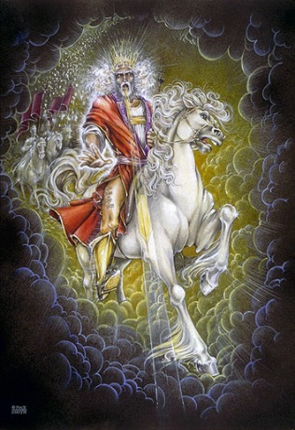
Growing in Holiness
2 PETER
The Blessed Hope is the certainty that our God and Savior Jesus Christ is retuning soon, just as He promised before the Day of the Lord, and when it does the world is going to burn (3:10). In light of this Peter tells us how we should then live.
Notes:
The message of Second Peter is about hope.
Instead of putting our hope in the world and ever investing in the things of this world, Peter tells us to put our hope in Christ. Instead of being misled by false promises of fame and glory in this world, we ought to live in the expectation of the prophetic promises of Jesus’ soon return to establish His glorious kingdom on earth until the conclusion of all things, and then at that time He will create an new heaven and new earth in which only righteousness will exists.
The more we are rooted in this promise and hope, the more we ought to live in holiness, adding good moral conduct to our faith, persevering in the midst of personal trials, and developing our Christian character all in the expectation of being rewarded with a rich entrance to Jesus’ future kingdom.

Slide 4
Growing in Holiness
2 PETER
Outline

Slide 5
Growing in Holiness
2 PETER
Salutation: Greeting and Blessing – 1:1-2
Prologue: The Basis and Basics of Holiness - 1:3-11
Purpose: To Establish Them in the Truth – 1:12-15
Body: Hold Fast the Hope of Christ’s Coming –
1:16 – 3:13
Epilogue: Parting Thoughts – 3:13-14

Slide 6
Growing in Holiness
2 PETER
Key Verse:
“Therefore, since all these things will be dissolved, what manner of persons ought you to be in holy conduct and godliness” (2 Peter 3:11)

Slide 7
Growing in Holiness
2 PETER
A Verse of Hope:
“Nevertheless we, according to His promise, look for new heavens and a new earth in which righteousness dwells” (2 Peter 3:13)

Slide 8
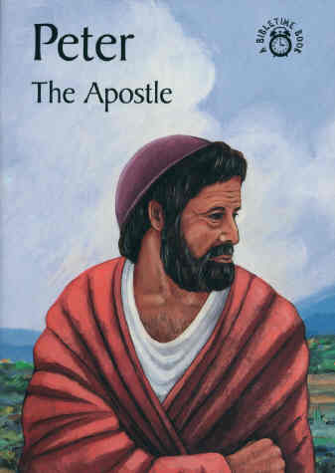
Growing in Holiness
2 PETER
The Salutation – 1:1-2
The Greeting – 1:1
“Simon Peter, a bondservant and apostle of Jesus Christ,” (1:1a)
First Peter – AD 64
Second Peter – AD 68
The Author
Notes:
Peter using the name “Simon Peter”. He may possibly combining these distinctly Hebrew and Jewish name as an indication of the mixed audience of Jews and Gentiles.
In the first letter Peter simply calls himself an apostle of Jesus Christ, but here he also describes himself as a “bondservant”, in sharp contrast with the arrogant and disobedient false teachers who will even deny “the Lord of bought them”. He is first Christ’s servant and His apostle second.

Slide 9
Growing in Holiness
2 PETER
The Salutation – 1:1-2
The Greeting – 1:1
“Simon Peter authorship called into question?
The Author
Notes:
Reasons

Slide 10
Growing in Holiness
2 PETER
Reasons for Questioning Peter’s Authorship
Not referred to by any early church fathers.
Early acceptance was slow due to fake letters by fake apostles.
Some questioned it because of stylistic differences.
The Author
Notes:
Not referred to by any early church fathers of the second century – Silence does not argue for or against Petrine authorship. The letter is short and was probably not widely circulated at first.
In the third century 2 Peter was referred to by several prominent church fathers. By the fourth century the Petrine authorship was strongly affirmed. Both Athanasius and Augustine considered 2 Peter as canonical. Jerome place it in the Latin Vulgate. And the third Council of Carthage recognized the intrinsic authority and worth of 2 Peter.
Its acceptance may have come slowly because of suspicion of other letters in the early church bearing the name by the apostles. Forgeries were fairly common in the early church. Even Paul warned about forged letters (2 Thess. 2:2). [There are pseudonymous writings as the Apocalypse of Peter, the Gospel of Peter and the Acts of Peter that were rejected]. Also, the letter was written not long before his death and so he was not around to verify its authenticity.
Jerome first pointed out the stylistic differences, but explain the differences by the fact that Peter used a scribe [Silvanus] in the first letter and not in the second. The differences are plausibly explained by the fact that the two letter contain different subject matter and different purposes. There may be just as many stylistic similarities as there are differences.
The two books are filled with what is known as “hapax legomena”, words that occur only once in the NT. There are proportionately more of these words than most NT books their size. In fact Homer K. Ebright concluded that the noticeable differences are not between the two Petrine Epistles but between these Epistles and the rest of the NT. This may point to a common author who had a rich vocabulary and a public speaker’s flare for fresh creative expression. (BKC, p. 860)

Slide 11
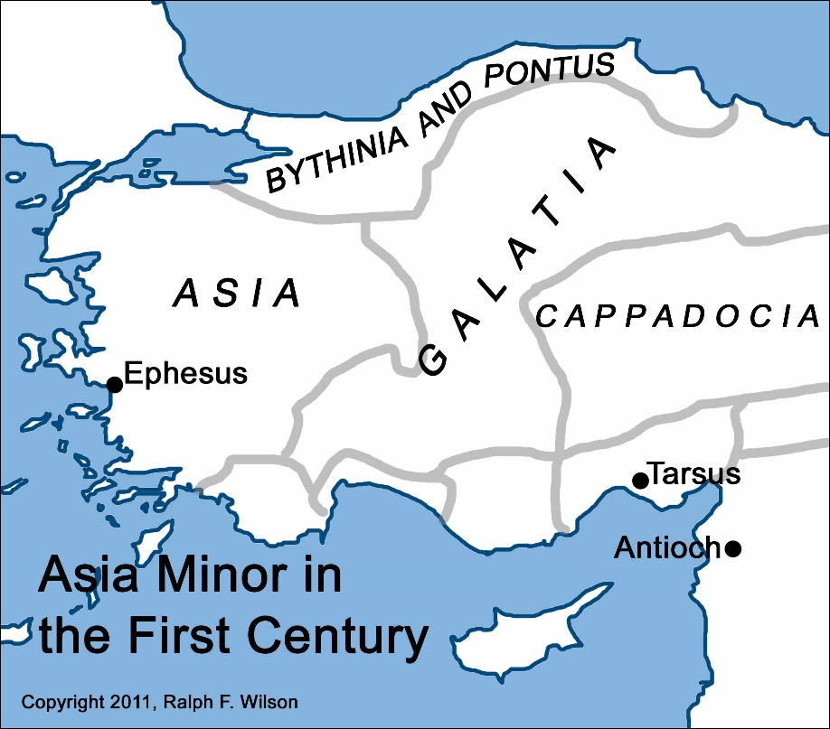
Growing in Holiness
2 PETER
The Salutation – 1:1-2
The Greeting – 1:1
“to the pilgrims of the dispersion in Pontus, Galatia, Cappadocia, Asia, and Bithynia…”
(1 Peter 1:1b)
The Audience
Notes:
They were aliens and dispersed Jews and Gentiles living in a foreign land. The current evil world is not our permanent home. Our stay here is only for a little while.

Slide 12
Growing in Holiness
2 PETER
The Salutation – 1:1-2
The Greeting – 1:1
“To those who have obtained like precious faith with us by the righteousness of our God and Savior Jesus Christ:”
The Audience
Notes:
The recipients of the letter are only described in general terms.
“To those who have obtained” is all one word in Greek and Gangel calls this an unusual verb, “lanchano” – “to obtain by lot” or by the will of God.
Many Calvinist believe that this is faith that is given to the believer in order that he may believe and be saved, saving faith is a gift of God, they say. The unbeliever must be given this faith since he has no ability at all to do so because he is dead in sin, unable to do anything – “totally inability”.
However, “faith” has no article which more likely means the subjective ability to believe. In other words, God does not give us the faith to believe, but He does give us, mankind that is, the ability to believe. If someone chooses not to believe it was not because he was not able, he could not, it was because he was not willing. If someone believes, he did so because he had not only possessed the ability to do so, he could believe, but also because he was willing to do so as well.
This faith is also “precious” or “of equal value”. The readers faith was every bit as much of value for them as it had been for the Apostles who were eyewitnesses of its reality. Its worth was not diminished by the fact that they themselves had not seen what the Apostles had seen, heard and touched.
“Their faith had obtained them a righteous standing before God (justification) and it also directed them toward righteous living. The full value of the faith could only be realized in one sphere, namely, the sphere of divine righteousness, both imputed (credited by faith alone), and experiential (lived out in their lives). As the epistle unfolds, it is clear that the false teachers threaten the readers’ experience of righteousness.” (Hodges, p. 16) The false teachers could not threated their imputed righteousness which belongs to them forever as a result of an irrevocable free gift from God received by faith alone.
The grammar here clearly indicates that “God and Savior” are one Person, not two. This passages ranks as one of the great Christological passages of the NT which plainly teaches that Jesus is coequal in nature with God the Father.

Slide 13
Growing in Holiness
2 PETER
The Salutation – 1:1-2
The Blessing – 1:2
“Grace and peace be multiplied to you in the knowledge of God and of Jesus our Lord.”
Growth
Notes:
There is a lot of mathematics in second Peter. He uses multiplication, which is magnified growth. In verse 5 of chapter one he going to say by giving all diligence that we can add to our faith. But failing to do so will result in subtraction, “the latter end is worse (morally) for them than the beginning.” (2:20) And the false teachers caused division.
Peter’s desire is that the readers might discover how God can multiply their experiences of His grace and peace. They already possessed grace and peace by faith, but who wants more?
“Grace and peace” is multiplied in the “knowledge” – “epignosei”, “additional or full knowledge of God, which implies a more intimate and personal relationship. Believers are urged to take advantage of the “full knowledge” available to them in Christ Jesus. The false teachers claimed to have special knowledge, usually obtained through some eccentric experience, visions and dreams delivered sometimes by angels.
This additional grace and peace though is only “in the knowledge of God and of Jesus our Lord.” Only as believers stay rooted in their knowledge of God and His Son and allow that knowledge to determine the direction of their lives—only by this will they truly experience, ever more abundantly God’s grace and peace. Failing to do so and being fooled by the false teachers will only lead into a quagmire of sin, the swamp.
Peter, a faithful shepherd of Christ’s flock, is writing so as to warn his fellow believers of the coming of false teachers who will lead them into the swamp.

Slide 14
Growing in Holiness
2 PETER
Prologue: [Introduction] – 1:3-11
The Basis of Holiness – 1:3-4
The Basics of Holiness – 1:5-11

Slide 15
Growing in Holiness
2 PETER
Prologue: [Introduction] – 1:3-11
The Basis of Holiness – 1:3-4
The Provisions for Holiness – 1:3
His Divine Power – 1:3
His Divine Promises – 1:4a
The Partakers in Holiness – 1:4b

Slide 16
Growing in Holiness
2 PETER
Prologue: [Introduction] – 1:3-11
The Basis of Holiness – 1:3-4
The Basics of Holiness – 1:5-11
The Characteristics of Holiness – 1:5-7
The Consequences of Holiness – 1:8-9
The Conclusiveness of Holiness – 1:10-11

Slide 17
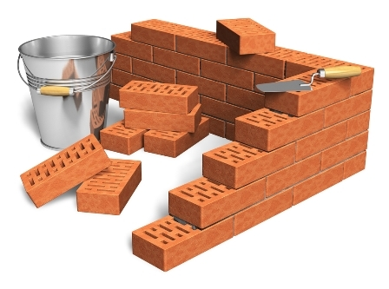
Growing in Holiness
2 PETER
The Prologue of the Letter – 1:3-11
The Basis of Holiness – 1:3-4
Notes:
Verses 3 and 4 is one sentence. The elaborate structure is intended to introduce the epistles’ prologue [Introduction], and is connected to verse 5-9.
“As (or since) His divine power has given to us…” (vv. 3-4)
“But also (or, and indeed) for this very reason… add to your faith.”
God’s gracious provision for us (vs. 3-4) is the foundational reason why we should follow through and add to our faith.
God’s divine power and precious promises are the basis of holiness, faith is the means by which we are able to access these characteristics. “God’s gracious provisions for us (vs. 3-4) is the foundational reason why we should follow through on the exhortation of vs. 5-9.” [Hodges, p. 18.]

Slide 18
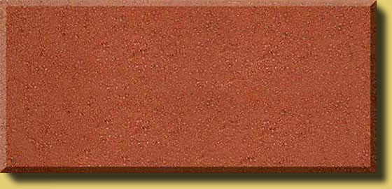
Growing in Holiness
2 PETER
The Basis of Holiness – 1:3-4
The Provision for Holiness – 1:3-4a
“His divine power has given to us all things that pertain to life and godliness,” (1:3a)
POWER
Notes:
It is God’s divine power that has sufficiently gifted us with all things related to life and godliness. Born-again believers have all that they could possible need to live a godly life. Nothing else is needed. Faith alone in Christ alone for eternal life. Divine power and His promise for life and godliness.
As Paul said, God “has blessed us with every spiritual blessings in the heavenly places in Christ” (Eph. 1:3). [See handout]
This provision includes the gift of the Holy Spirit Himself, including the baptism, indwelling and sealing of the Holy Spirit at the moment of faith in Christ is exercised. There is no second, third or fourth blessing or experience needed. No need to later receive the baptism of the Holy Spirit, evidence by speaking in tongues, etc. in order to be fully equipped and empowered for a victorious life in Christ. Every believer receives and is baptized by the Holy Spirit, becoming a child of God and placed into the body of Christ, instantaneously uniting us spiritually with the rise and ascended Christ, at the very moment one believes in Christ alone.
“power” [dunamis] It is not explosive or destructive power, such as “dynamite”, but an ability or strength given to us all who in Christ by faith. This power pertains to life [zoe], the new life received at salvation, and godliness [eusebeia] / holiness.

Slide 19
Growing in Holiness
2 PETER
The Basis of Holiness – 1:3-4
The Provision for Holiness – 1:3-4a
“by which have been given to us exceedingly great and precious promises,” (1:4a)
POWER
PROMISE
Notes:
God has also given us “exceedingly great and precious promises.” Now God has given us the promise of eternal life. ”And this is the promise that He has promised us — eternal life” (1 John 2:25). Peter has had previously written about promises related to a believer’s inheritance (1 Peter 1:3-5).
God has given many other promises, but the promises that Peter has in mind are the promises that God has given us in order that we live godly in this life. And these promises are also the means by which we can become partakers of God’s nature.
What promises are these? At the very least, they must be the prophetic promises so strongly emphasized in this letter, which Peter had previously made know to them concerning the power and the coming of the Lord Jesus Christ (1:16) It is the promise of His coming (3:4, 9, 13) and all of the accompanying promises related to His promised return. [See Psalm 72]

Slide 20
Growing in Holiness
2 PETER
The Basis of Holiness – 1:3-4
“two men [angels] stood by them in white apparel, who also said, ‘Men of Galilee, why do you stand gazing up into heaven? This same Jesus, who was taken up from you into heaven, will so come in like manner as you saw Him go into heaven.” (Acts 1:10-11)
POWER
PROMISE
Notes:
The promise of His returned was announced by two angels on the Mt. of Olives as Jesus ascended into heaven.
One of the great lessons of second Peter is that to maintain a holy life in a corrupt world like ours, we must be deeply rooted in the prophetic promises of God’s word. We must hold fast/ stand to the “blessed hope” of the coming again and return of our Lord and Savior Jesus Christ. Failing to do so only leads to an absence of readiness.

Slide 21
Growing in Holiness
2 PETER
“But if that evil servant says in his heart, 'My master is delaying his coming,' and begins to beat his fellow servants, and to eat and drink with the drunkards, the master of that servant will come on a day when he is not looking for him and at an hour that he is not aware of…” (Matt. 24:48-51)
POWER
PROMISE
Notes:
For this very reason the Lord wanted us always to be ready. It might not be today, or next week, month, next year, He may not actually come for another 10 years, or 100 years from now and even possibly a 1000 years, it matters not when it will be, what matters is, we are to live as if it were today.
If we are ready then,

Slide 22
Growing in Holiness
2 PETER
“Blessed is that servant whom his master, when he comes, will find so doing. Assuredly, I say to you that he will make him ruler over all his goods.” (Matt. 24:46-47)
POWER
PROMISE

Slide 23
Growing in Holiness
2 PETER
The Basis of Holiness – 1:3-4
The Provision for Holiness – 1:3-4a
“by which have been given to us exceedingly great and precious promises,” (1:4a)
POWER
PROMISE
Notes:
The promise of His return has are extremely valuable and importance reliance to our growing in holiness. What we believe concerning His coming has great implications for our life now and in the future.

Slide 24
Growing in Holiness
2 PETER
The Basis of Holiness – 1:3-4
The Partakers of Holiness – 1:4b
“that through these you may be partakers of the divine nature, having escaped the corruption that is in the
world through lust.”
PARTAKE
POWER
PROMISE
Notes:
It is through these very great and valuable promises that we discover God’s purpose in given them, that we can [koinonos] “participate”, literally “become partners” or “sharers” in God’s nature and in addition escape the corruption in this world. God’s gift of divine power and promises are the means by which we can partake in His divine nature.
And as Simon J. Kistemaker points out it is His divine nature, not His divine person, essence and substance, that we are able to share. We can share in God communicable or transmissible attributes, such as, love, joy, peace, patience, kindness, goodness, faithfulness, gentleness, self-control” (Gal 5:22-23). What we cannot share in is God’s incommunicable attributes, such as His omni-attributes…
“Because of the promise the new birth (1 Pt. 1:3), the promise of God’s protecting power (1 Pt. 1:5) and the promise of God’s enabling power (2 Pt. 1:3) believers can “participate” in the divine nature, that is, become more like Christ.” [Gangel, BKC, p. 864)
The Greeks philosophers taught man should share in the divine nature of the gods, who were in their estimation as corrupt as humanity. The pagan temples were places where men and women could go and participate in various physical and sexual pleasures, and by doing so they would be communing with and sharing in the (corrupt) nature of the gods.
It is within this context that Peter establishes a sharp contrast between the Christian concept of partaking in God’s holy divine nature and that of the Greekenized world, and the false teachers.
It is through the promises in Christ, we can obtain holiness and in addition escape corruption and decay. By becoming “partakers” of God’s divine holy nature believers can share in His moral victory over sin in this life as we have already secured victory over death itself through the gift of eternal life by faith.

Slide 25
Growing in Holiness
2 PETER
The Basis of Holiness – 1:3-4
“through the knowledge of Him who called us by glory and virtue,” (1:3b)
PARTAKE
POWER
PROMISE
KNOWLEDGE BASED FATIH
GOD’S GLORY AND VIRTUE
Notes:
Moreover, Peter informs us that this ability came to us “through the knowledge of Him who called us by glory and virtue / moral excellence. Eternal life itself is the knowledge of God and Christ. We cannot receiver eternal life apart from the knowledge of Him, of His person and His provision. Our faith is placed into the knowledge of Christ’s person and work. When we come to know Christ by faith, it is by this means that we are now made recipients of this spiritual equipping and empowering.
It is knowledge based faith in Christ that is the means by which we can access God’s power and promises, and these are the means be which we be partakers, sharers, or participates in God’s nature and escape the lust-driven corruption of the world in which we presently live.
In addition, the One we come to know by faith and are called is glorious and virtuous. Christ has called / invited us by His word to experience knowing Him. This call is by glory and moral excellence. The divine call that lead to our salvation is an expression of His glory and virtue. Nothing is more glories and excellent that the gospel invitation of God’s free salvation. Therefore, the call magnifies God’s character and enhances His glory.

Slide 26
Growing in Holiness
2 PETER
The Basic of Holiness – 1:5-11
The Characteristics of Holiness – 1:5-7
“But also for this very reason, giving all diligence, add to your faith virtue, to virtue knowledge, to knowledge, self control, to self control perseverance, to perseverance godliness, to godliness, brotherly kindness, brotherly kindness love.”
Notes:
Adding to your faith is equivalent to leaving the elementary principles of Christ and going on to maturity (Heb. 6:1)

Slide 27
Growing in Holiness
2 PETER
LOVE
BRO. KINDNESS
GODLINESS
The Characteristics
of Holiness – 1:5-7
PERSEVERANCE
SELF CONTROL
KNOWLEDGE
VIRTUE
FAITH

Slide 28
Growing in Holiness
2 PETER
LOVE
BRO. KINDNESS
GODLINESS
The Consequences
of Holiness – 1:8-9
PERSEVERANCE
SELF CONTROL
KNOWLEDGE
VIRTUE
FAITH

Slide 29
Growing in Holiness
2 PETER
LOVE
Qualities that Produce Active, Fruitful Christians
BRO. KINDNESS
GODLINESS
PERSEVERANCE
SELF CONTROL
The Absence of these Qualities will Produce a Blind and Shortsighted Life
KNOWLEDGE
VIRTUE
FAITH
Notes:
Peter’s has presented the case for developing moral qualities. If these characteristics or qualities are diligently pursued they will produce active, fruitful Christians. If these qualities are not pursued with all diligence then they will produce the opposite, a blind and shortsighted life.
The personal results of the presence or absence of these qualities affect our present quality of life in the here and now. But they also carry with them other results of a broader scoop.

Slide 30
Growing in Holiness
2 PETER
The Basic of Holiness – 1:5-11
The Consequences of Holiness – 1:8-9
“For if these things are yours and abound, you will be neither barren, nor unfruitful in the knowledge of our Lord Jesus Christ.” (1:8)
Notes:
If you do not exhibit these characteristics of holiness [godly conduct] in your life and you fail to diligently seek them, then you will be barren of spiritual life and you will not be fruitful, and blessed of the Lord. As James would say, you will possess a faith that is dead, useless and unproductive. You will have faith, but nothing to show for it.

Slide 31
Growing in Holiness
2 PETER
The Basic of Holiness – 1:5-11
The Consequences of Holiness – 1:8-9
The seed that was “sown among the thorns; are the ones who hear the word, and the cares of this world, the deceitfulness of riches, and the desires of other things entering in choke the word, and it becomes unfruitful.” (Mark 14:19)
Notes:
The seed that falls among the thorns are those who life is choked out with the cares, riches, and pleasures of this life, “and brings no fruit to maturity” (Luke 8:14)
“but if the earth bear thorns and briers, it is rejected and near to being cursed, whose end is to be burned.” (Heb. 1:8)

Slide 32
Growing in Holiness
2 PETER
The Basic of Holiness – 1:5-11
The Consequences of Holiness – 1:8-9
“For if these things are yours and abound, you will be highly productive, and extremely fruitful in the knowledge of our Lord Jesus Christ.” (1:8)
Notes:
“But the seed that fell on the good ground are those who, having heard the word with a noble and good heart, keep it, and bear fruit with patience.” (Luke 8:15)

Slide 33
Growing in Holiness
2 PETER
The Basic of Holiness – 1:5-11
The Consequences of Holiness – 1:8-9
“But the see that fell onto the good ground, are those who hear the word, accept (believe) it, and bear fruit: some thirtyfold, some sixty, and some a hundred” (Mark 14:20)

Slide 34
Growing in Holiness
2 PETER
The Basic of Holiness – 1:5-11
The Consequences of Holiness – 1:8-9
“But he who received the seed on the good ground (believed unto eternal life) is he who hears the word and understands it, who indeed bears fruit and produces: some hundredfold, some sixty, some thirty” (Matthew 13:23)

Slide 35
Growing in Holiness
2 PETER
The Basic of Holiness – 1:5-11
The Consequences of Holiness – 1:8-9
“For he who lacks these things is shortsighted, even to blindness, and has forgotten that he has been cleansed from his old sins.” (1:9)

Slide 36
Growing in Holiness
2 PETER
The Basic of Holiness – 1:5-11
The Consequences of Holiness – 1:8-9
“For he who possesses the characteristics of holiness and pursues them in excess is farsighted, even perceptive, and remembers that he has been cleansed from his old sins.” (1:9)

Slide 37
Growing in Holiness
2 PETER
LOVE
BRO. KINDNESS
GODLINESS
The Conclusiveness
of Holiness – 1:10-11
PERSEVERANCE
SELF CONTROL
KNOWLEDGE
VIRTUE
FAITH
Notes:
Peter’s has presented the case for developing moral qualities. If these characteristics or qualities are diligently pursued they will produce active, fruitful Christians. If these qualities are not pursued with all diligence then they will produce the opposite, a blind and shortsighted life.
The personal results of the presence or absence of these qualities affect our present quality of life in the here and now. But they also carry with them other results of a broader scoop.

Slide 38
Growing in Holiness
2 PETER
LOVE
BRO. KINDNESS
Verification of Our Election for Service
GODLINESS
PERSEVERANCE
SELF CONTROL
A Magnificent Entrance into the Kingdom of God
KNOWLEDGE
VIRTUE
FAITH
Notes:
But they also carry with them other results of a broader scoop.

Slide 39
Growing in Holiness
2 PETER
The Basic of Holiness – 1:5-11
The Conclusiveness of Holiness – 1:10-11
“Therefore, brethren, be even more diligent to make you call and election sure, for if you do these things you will never stumble;” (1:10)
Notes:
Peter has thus far argued for the moral development presented in vs. 5-7 on the basis of God’s gracious provisions for Christian living (vs. 3-4) and on the basis of the personal results, both positive and negative, that the presence or absence of these traits produce (vs. 8-9)
Peter has already given a quite adequate reason to motivate believers to diligence in spiritual growth. Now he present an even more diligent reason. The personal results affects our present quality of life and our future quality of life as well. It includes verification of our election for service and a magnificent entrance into the coming eternal kingdom of God.
All Christians are called to pursue godliness and grow in holiness. Not all will we do so, therefore not all will be chosen to serve in His kingdom. However, if you do these things you will prove yourselves not ‘”chosen” for salvation, but “chosen’ for divine reward. You will not run the risk of losing your rewards you are “called to obtain.
“However, the false teachers, if they are listen too, could cause you to stumble and cause you to lose your reward.

Slide 40
Growing in Holiness
2 PETER
The Basic of Holiness – 1:5-11
The Conclusiveness of Holiness – 1:10-11
“For many deceivers have gone out into the world who do not confess Jesus Christ as coming in the flesh. This is a deceiver and an antichrist. Look to yourselves, that we do not lose those things we worked for, but that we may receive a full reward.” (2 John 7-8)
Notes:
“For many deceivers have gone out into the world who do not confess Jesus Christ as coming in the flesh (or confess Jesus coming in the flesh; His coming is only spiritual) This is a deceiver and an antichrist. Look to yourselves, that we do not lose those things we worked for, but that we may receive a full reward” (2 John 7-8)

Slide 41
Growing in Holiness
2 PETER
The Basic of Holiness – 1:5-11
The Conclusiveness of Holiness – 1:10-11
“And we desire that each one of you show the same diligence to the full assurance of hope until the end, that you do not become sluggish, but imitate those who through faith and patience inherit the promises.” (Hebrews 6:11-12)
Notes:
“And we desire that each of you show the same diligence to the full assurance of hope until the end that you do not become sluggish, but imitate those who through faith and patience inherit the promises.” (Heb. 6:11-12)

Slide 42
Growing in Holiness
2 PETER
The Basic of Holiness – 1:5-11
The Conclusiveness of Holiness – 1:10-11
“for so an entrance will be supplied to you abundantly into the everlasting kingdom of our Lord and Savior Jesus Christ” (1:11)
Notes:
This is the climax of those who diligently seek and pursue holiness. Everlasting wealth in an everlasting kingdom. It can be yours if ye seek first the everlasting kingdom.

Slide 43
Growing in Holiness
2 PETER
Conclusion
Notes:
Are you ready for the blessed hope? In light of the Lord and Saviors’ soon return and the gracious provisions He has provided, diligently seek to grow in holiness in the knowledge of great God and Savior, Jesus Christ. Be ready to add good works to your faith? Not to obtain salvation, but to add to your salvation, added abundant life to your already eternal life.

Slide 44
Growing in Holiness
2 PETER
LOVE
BRO. KINDNESS
Verification of Our Election for Service
GODLINESS
PERSEVERANCE
SELF CONTROL
A Magnificent Entrance into the Kingdom of God
KNOWLEDGE
VIRTUE
FAITH
Notes:
Be ready to add good works to your faith… Not to obtain salvation, or to verify your salvation, but to add to your salvation, adding abundant life to your already existing eternal life. Adding a magnificent entrance to your entrance into His eternal kingdom.

